Slide 1

Basic Details of the Team and Problem Statement
Ministry/Organization Name/Student Innovation:
Rashtriya Ispat Nigam Limited, Visakhapatnam Steel Plant
PS Code: SIH1332
Problem Statement Title:Hot metal, Steel Ladle, and Scrap pot Tracking by auto-capturing the Ladle number and locations at SMS-1 and SMS-2.
Team Name: TechTribe
Team Leader Name: Nigamananda Behera
Institute Code (AISHE): C-42709
Institute Name: Institute of Technical Education & Research (Faculty of Engineering and Technology)
Theme Name: Transportation & Logistics

Slide 2
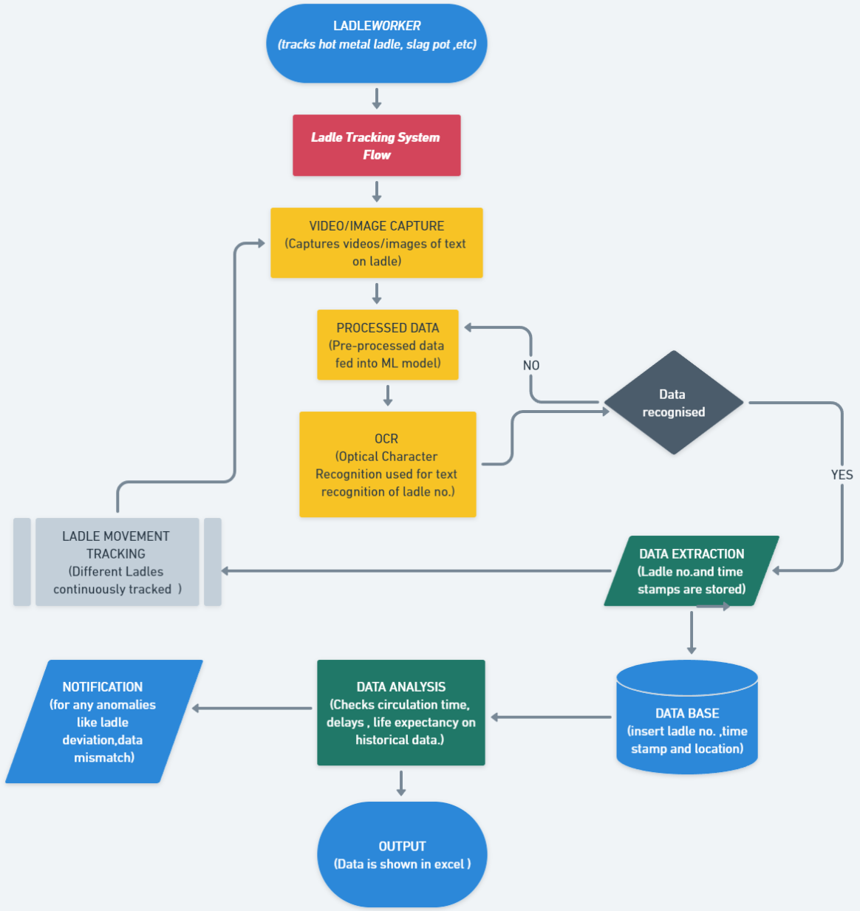
Idea/Approach Details
Describe your idea/Solution/Prototype here:
Our solution will track the hot metal ladles and slag pots used in steel melting plants.
Using just a video/photo from a camera that is strategically placed near a ladle we will be able to recognize the ladle number.
Automatic date and time will be added to the database.
Data analysis can be done such that we can find the total time taken in a complete cycle, life expectancy of each ladle, maintenance prediction, etc.
Automation of task without any human interference and real time data entry.
It will be easy to install, maintain, and will offer huge scalability.
Describe your Technology stack here:
Machine Learning Frameworks: OpenCV, PyTorch/TensorFlow
Database Management: PostgreSQL
Server-side Programming: Python, Node.js
API Frameworks: Flask/Django, RESTful
Data Analysis Tools: Pandas, NumPy libraries
Integration: Docker

Slide 3
Idea/Approach Details
Describe your Use Cases here
Describe your Dependencies / Show stopper here
Can be used in Steel melting workshops.
Monitor the real-time movement and location of ladles(hot metal ladles, steel ladles, slag pots) and Ensure that ladles are where they are supposed to be and prevent unauthorized access to hazardous areas.
Eliminate manual data entry errors and improve data accuracy.
Calculate the time it takes for each ladle to complete a full cycle through various checkpoints.
Analyze historical data to predict the remaining lifespan of each ladle.
Enable remote monitoring of ladle movements and data access, allowing for off-site supervision and decision-making.
Dependency on reliable camera infrastructure at ladle checkpoints and network connectivity for data transmissions.
Dependence on clear and high-quality ladle number markings on ladles for accurate recognition.
Availability of sufficient labeled data for ML model training.
Compatibility with the existing database infrastructure in the steel plant.
Implementation of robust security measures to protect data integrity and prevent unauthorized access.
Insufficient camera coverage or hardware limitations can hinder real-time ladle tracking.

Slide 4
Team Member Details
Team Leader Name: Nigamananda Behera
Branch : B.Tech Stream : CSE Year : III
Team Member 1 Name: Debajyoti Senapati
Branch : B.Tech Stream : CSE Year : III
Team Member 2 Name: Devdutt Mohapatra
Branch : B.Tech Stream : CSE Year : III
Team Member 3 Name: Manisha Acharya
Branch : B.Tech): Stream : CSE Year : III
Team Member 4 Name: Yash Kumar
Branch : B.Tech Stream : CSE Year : III
Team Member 5 Name: Subhankar Patel
Branch : B.Tech Stream : CSE Year : III
Team Mentor 1 Name: Type Your Name Here
Category (Academic/Industry): Expertise (AI/ML/Blockchain etc): Domain Experience (in years):
Team Mentor 2 Name: Type Your Name Here
Category (Academic/Industry): Expertise (AI/ML/Blockchain etc): Domain Experience (in years):

